Slide 1


Social Buzz
Analysis

Slide 2


Today's agenda
Project recap
Problem
The Analytics team
Process
Insights
Summary

Slide 3

Social Buzz is a fast-growing technology unicorn that needs to adapt quickly to its global scale.
Accenture has begun a 3-month POC focusing on these tasks:
An audit of Social Buzz's big data practice
Recommendations for a successful IPO
Analysis to find Social Buzz's top 5 most popular categories of content
Project Recap

Slide 4

Problem
Business Challenge: Social Buzz is rapidly scaling across global markets and needs data-driven insights to ensure its content strategy aligns with user interests. As content engagement is a key driver of platform growth and valuation, identifying the most engaging content categories is critical.
Key Question:
Which content categories generate the highest engagement and sentiment from users?
Strategic Importance:
Enables data-informed content and marketing strategies
Drives higher user engagement and retention
Supports strategic decisions in preparation for IPO

Slide 5



Andrew Fleming
Chief Technical Architect
The Analytics team
Marcus Rompton
Senior Principle
Sahil Jena
Data Analyst

Slide 6
Process
1
Data Understanding
Step 1: Merged all datasets using VLOOKUP (base = Reaction table)
Step 2: Cleaned dataset to include Category, Score, and Date
Step 3: Calculated total sentiment score per category using SUMIF
Step 4: Counted total reactions per category using COUNTIF
Step 5: Extracted posting trends per month using MONTH and YEAR functions, and summarized with Pivot Tables
2
Data Cleaning
3
Data Modelling
4
Data Analysis
5
Uncover Insights

Slide 7

Insights
Total unique categories: 15
Category with Highest Number of Reactions:
Animals: 1,897 reactions
Month with the Most Posts:
May 2021 with 2,138 posts

Slide 8
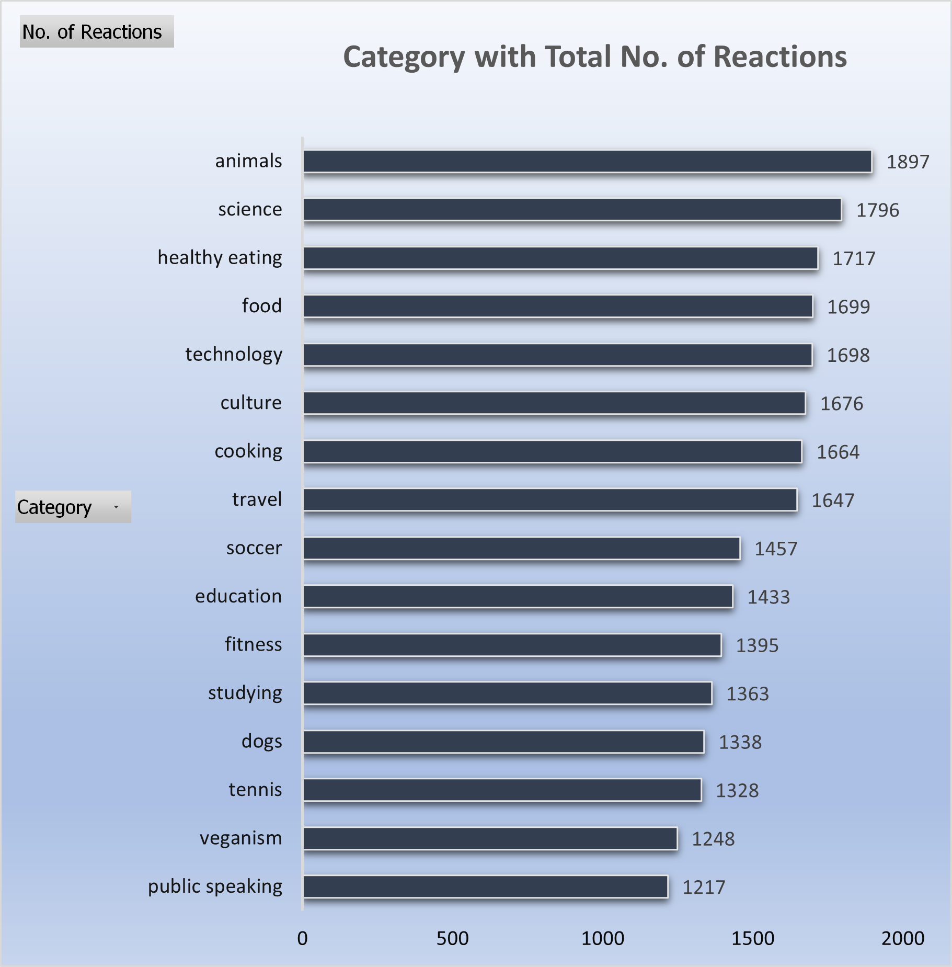
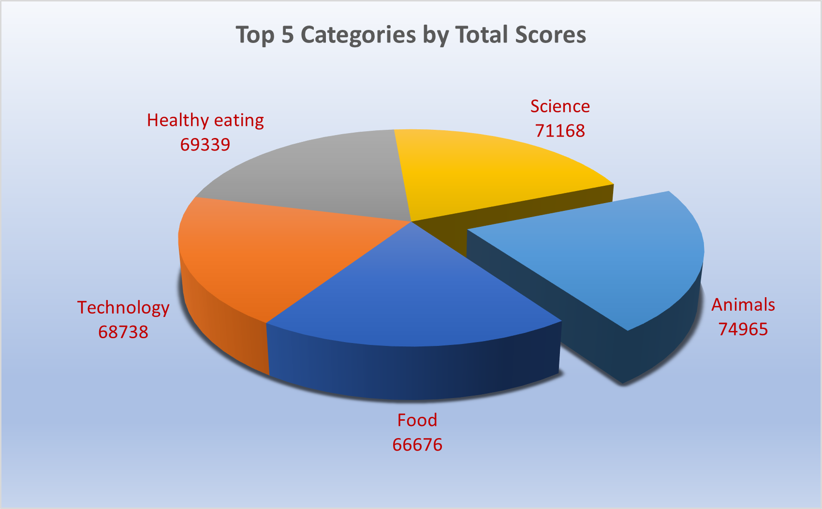

Slide 9
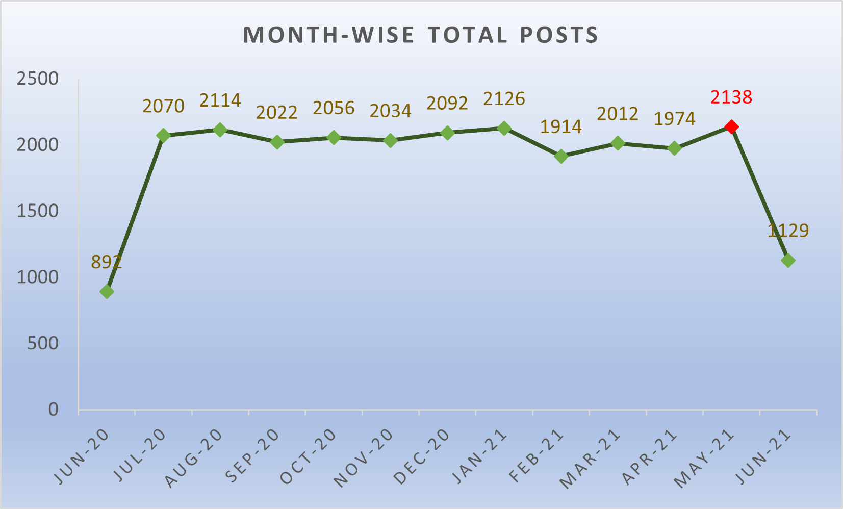

Slide 10

Animals is the most engaging category both by score and reactions.
15 unique content categories identified across the dataset.
Posting volume peaked in May 2021, followed closely by Jan 2021 and Aug 2020
Recommendation:
Prioritize top categories (Animals, Science, Healthy Eating).
Consider timing content around historically high-engagement months
Summary

Slide 11

Thank you!
ANY QUESTIONS?

